Slide 1
Social Distancing Detector
A Social Distancing Detector using Computer Vision

Slide 2
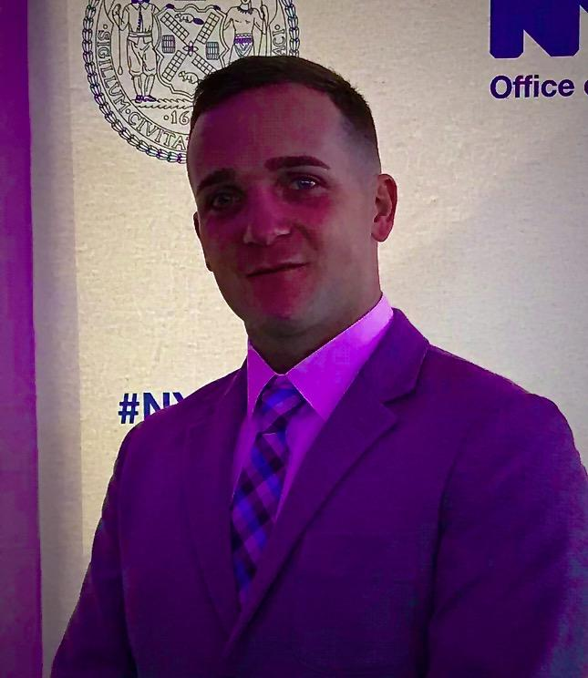
Presenter
Thomas Joy II
Data Scientist
Bachelor’s in Mathematics at Hunter College CUNY with a Minor in Computer Science
Pursuing Masters in Applied Mathematics
United States Marine Corps Veteran and Air Force Reservist

Slide 3
What is it?
Why is it so important?
01
04
How do you practice it?
What is a respiratory virus?
02
05
Social Distancing
What’s its history?
What’s the danger if people don’t follow social distancing?
03
06
Social distancing, also called “physical distancing”, means keeping a safe space between yourself and other people who are not from your household.
Social distancing is one of a number of tools, and the best non-pharmaceutical tool, that can slow the spread of a respiratory virus.
To practice social or physical distancing, stay at least 6 feet (about 2 arms’ length) from other people who are not from your household in both indoor and outdoor spaces.
Respiratory syncytial virus, or RSV, is a common respiratory virus that usually causes mild, cold-like symptoms.
Social distancing is by no means a new concept. Humans have been utilizing the idea behind social distancing for centuries. It even goes back to as early as the 14th century, where they used to create leper colonies and lazarettos as a means of preventing the spread of leprosy.
Most people recover in a week or two, but RSV can be serious, especially for infants, older adults, and people who are immunocompromised.

Slide 4
Motivations
The world we live in today with COVID-19
The more people don’t social distance and follow mask requirement, the worse this pandemic will get
Wanted to utilize my background in mathematics and apply it to data science
Neural Networks and Computer Vision is really cool!
Industrial Utilizations
Some industries that can implement a social distancing detector are:
Police Departments and Law Enforcement Agencies
CDC, WHO, and other Public Health Agencies
Academia
Some industries that can implement a distancing detector in general are:
DoD and other Government Agencies
Security Agencies
Smart Vehicles (i.e. Smart cars, Aircraft Autopilot, ect.)

Slide 5
Datasets
Image Datasets
Video Dataset
Training Dataset
Input
Validation Dataset
Testing Dataset
Consists of 300 images
Web Scraped off Google Images Manually
Annotated Categories Using Makesense.ai
Contains three categories
Man
Woman
Child
43 minutes of video footage
Video footage from security camera in parking lot
Consists of 50 images
Web Scraped off Google Images Manually
Annotated Categories Using Makesense.ai
Contains three categories
Man
Woman
Child
Consists of 20 images
Web Scraped off Google Images Manually
Annotated Categories Using Makesense.ai
Contains three categories
Man
Woman
Child

Slide 6
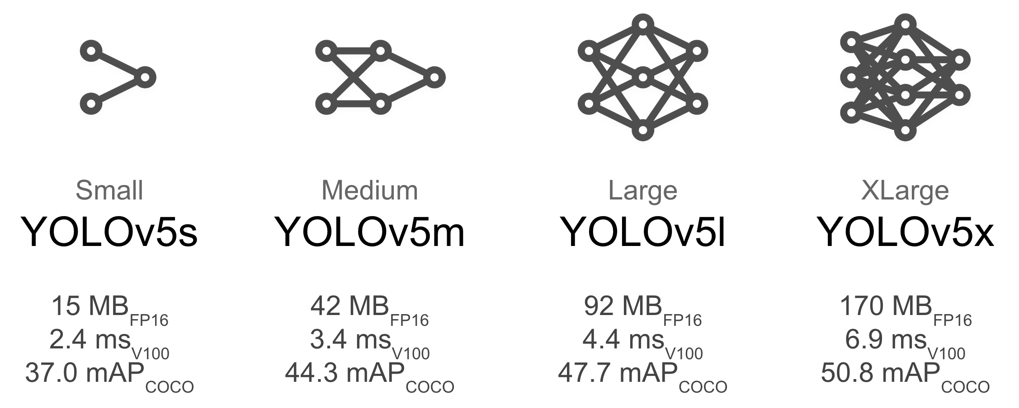
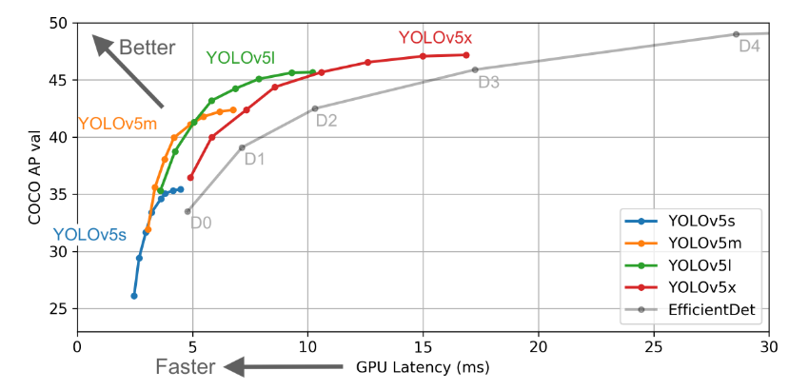

YOLOv5
Yolov5 is the newest version of YOLO, which is a real-time object detection framework and stands for You Only Look Once. Meaning the image is only passed once through the FCNN or Fully Convolutional neural network.
Image credit: github.com/ultralytics/yolov5
Image credit: github.com/ultralytics/yolov5
Image credit: github.com/ultralytics/yolov5

Slide 7
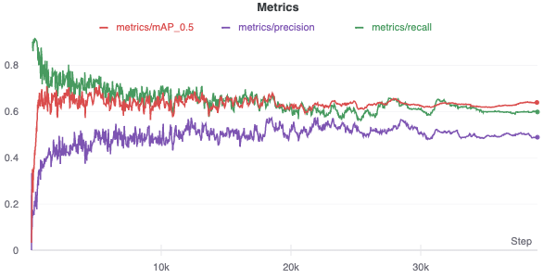
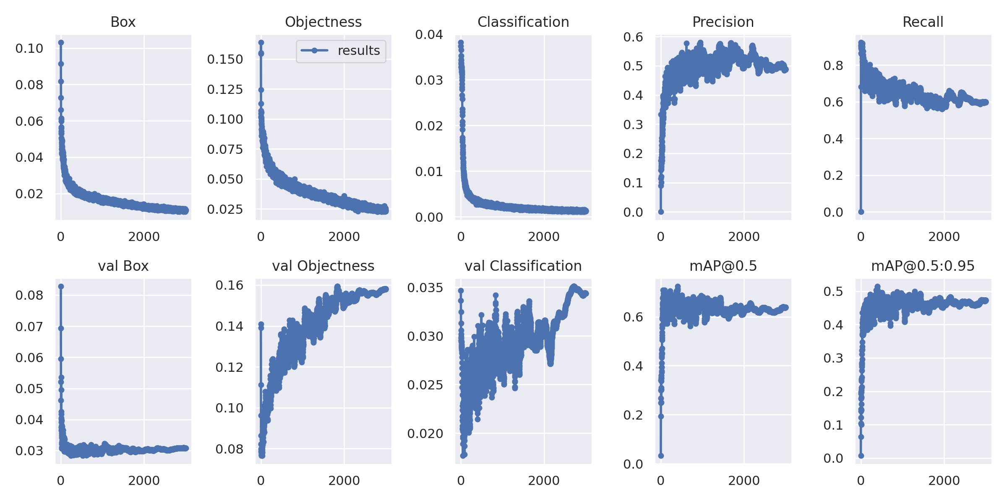
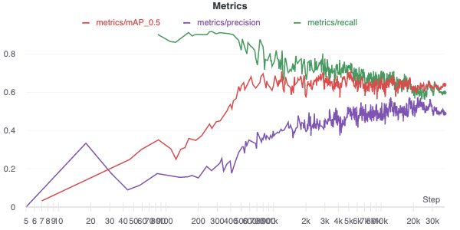
Training
Mean Average Precision(mAP_0.5): 0.64
Precision: 0.49
Recall: 0.60

Slide 8
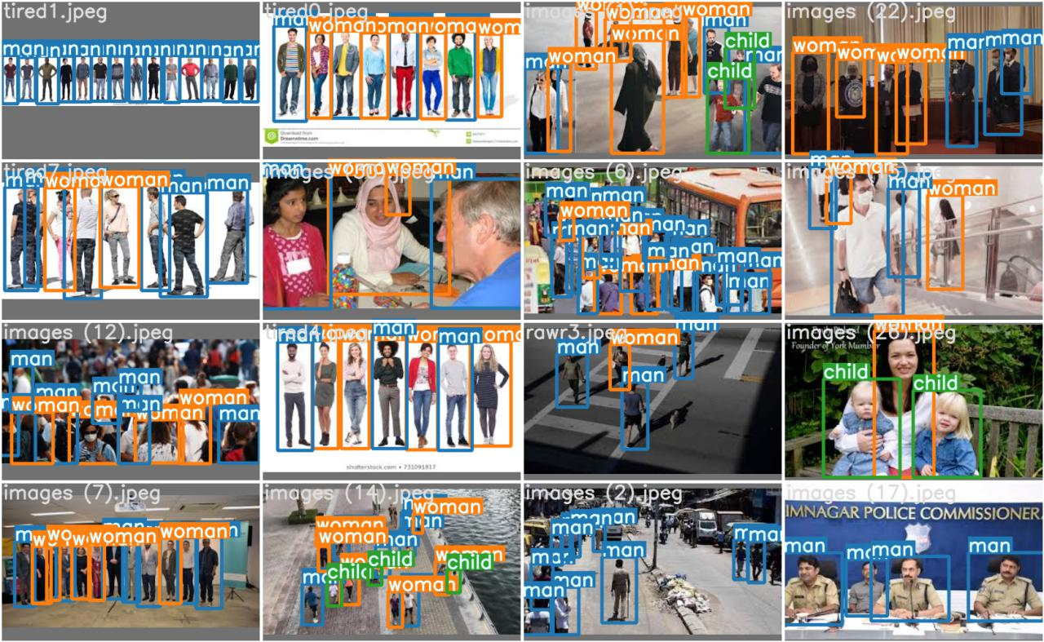
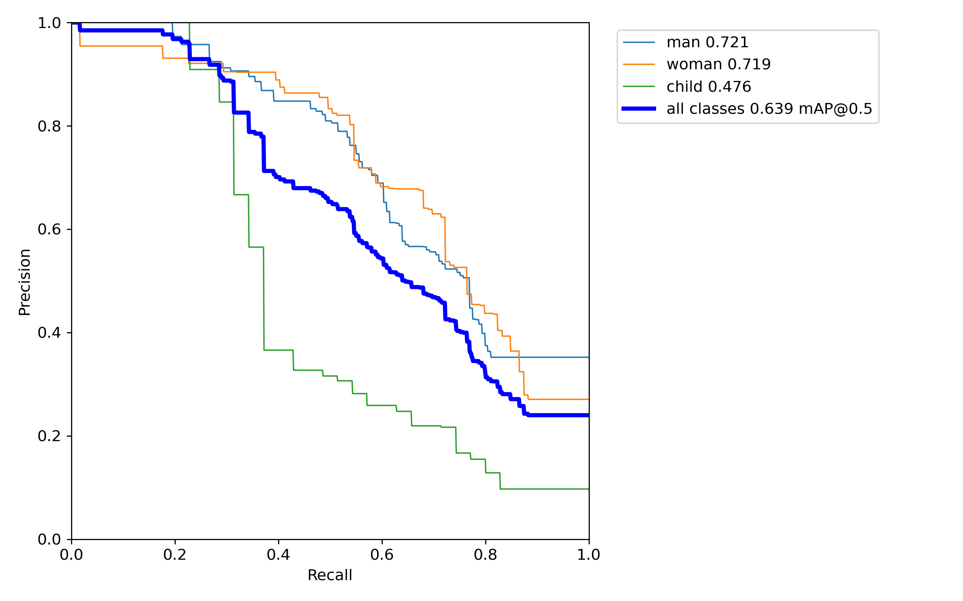
Validating

Slide 9
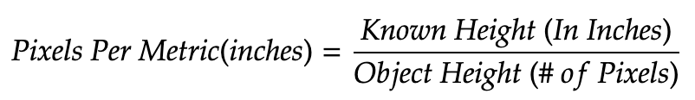
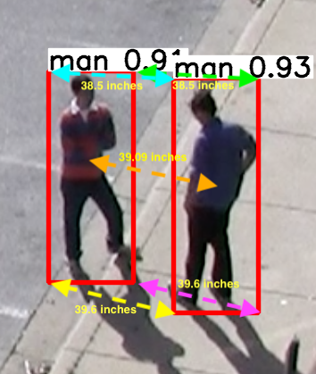
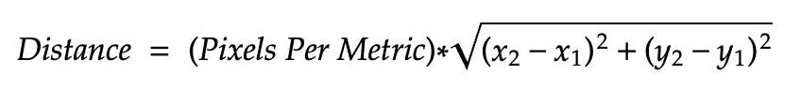
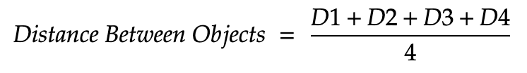
The Math Behind Calculating Distance

Slide 10
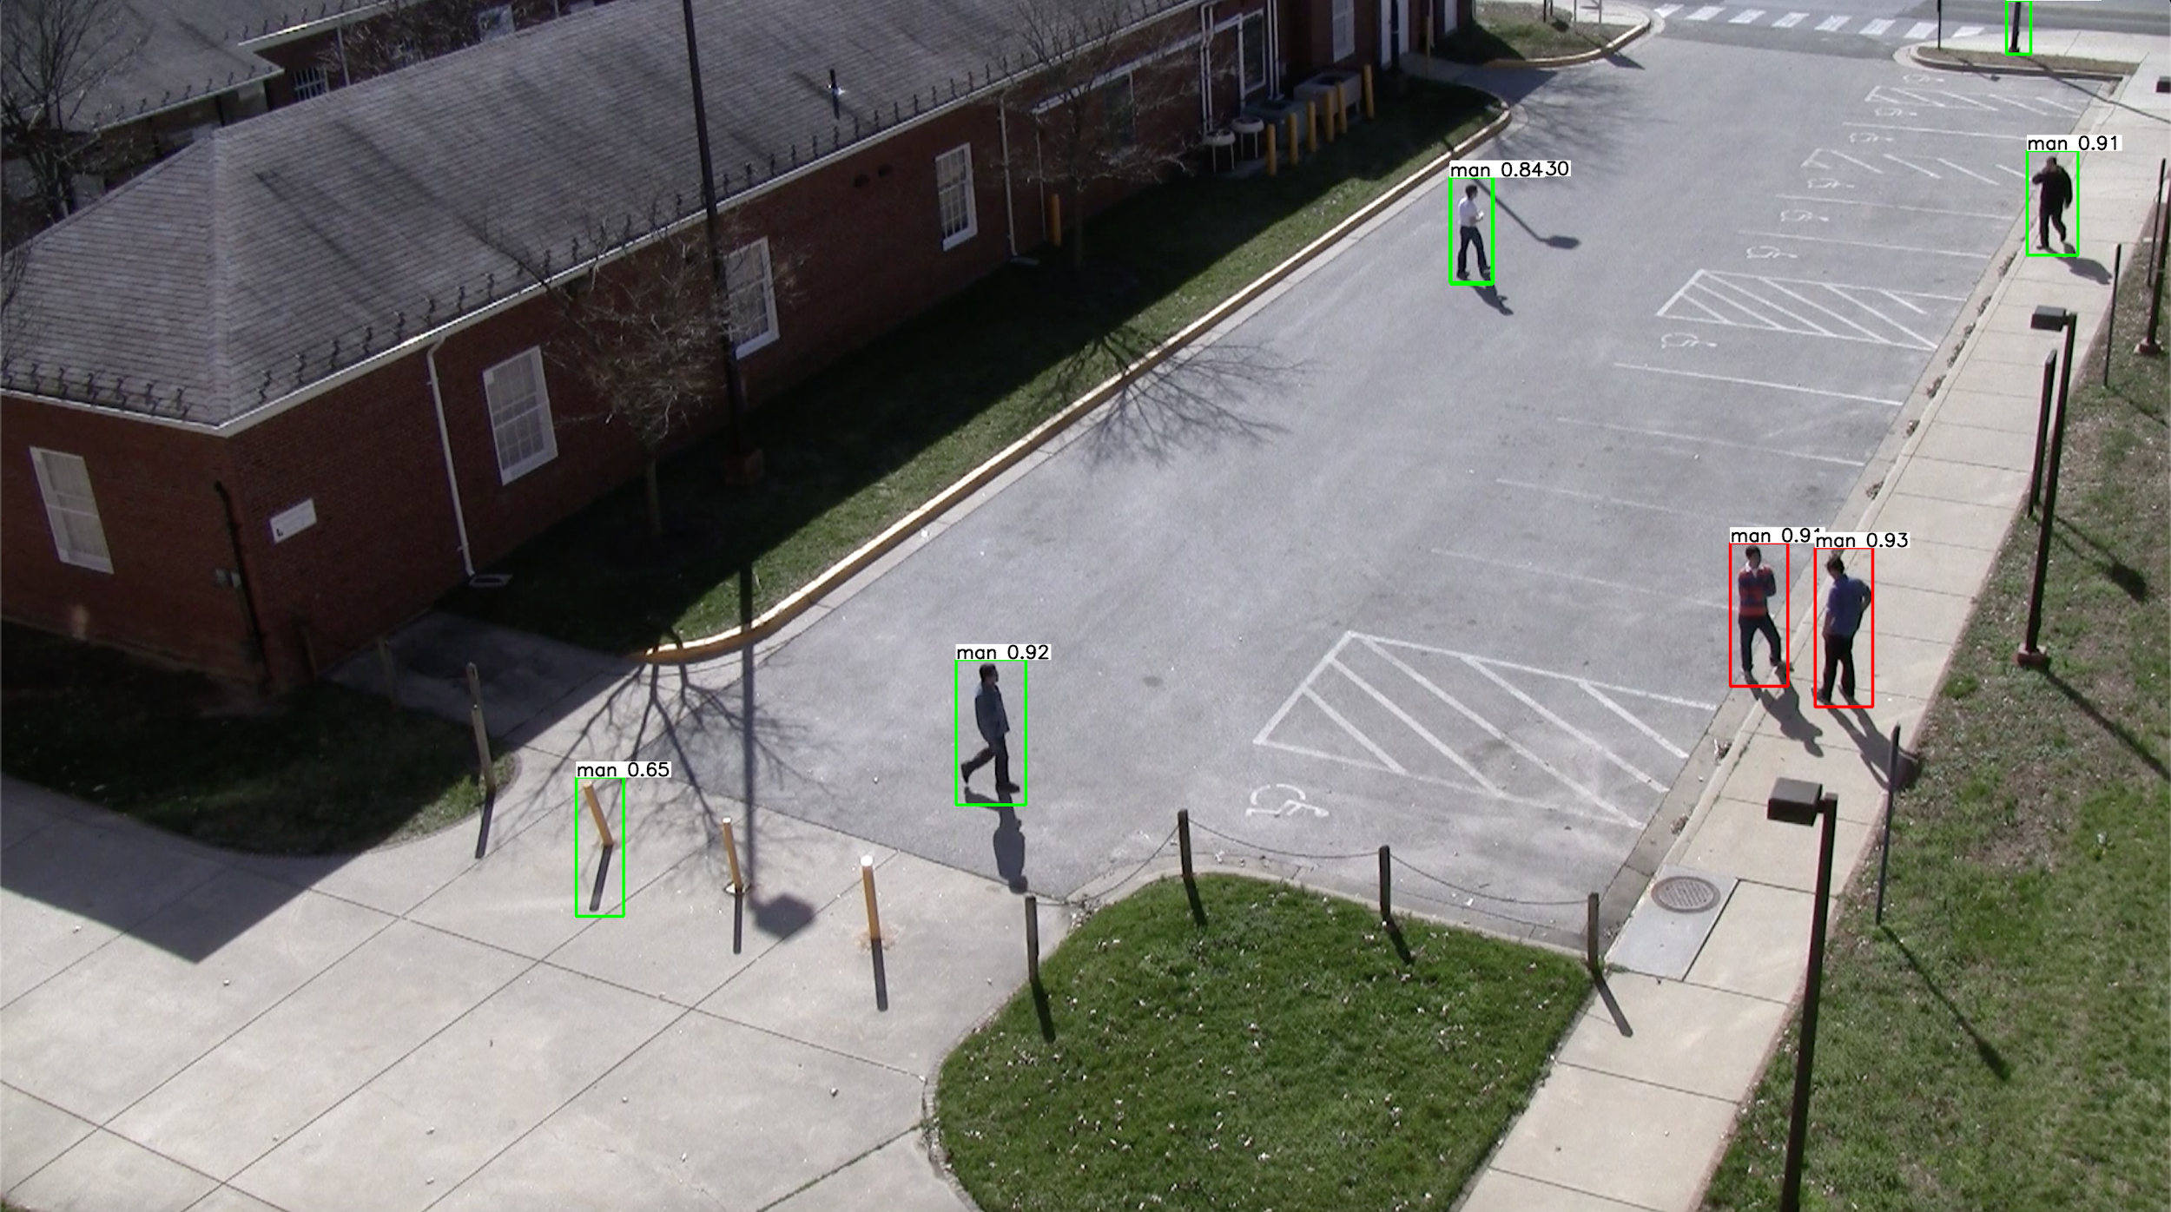
Applying Social Distancing Detector

Slide 11
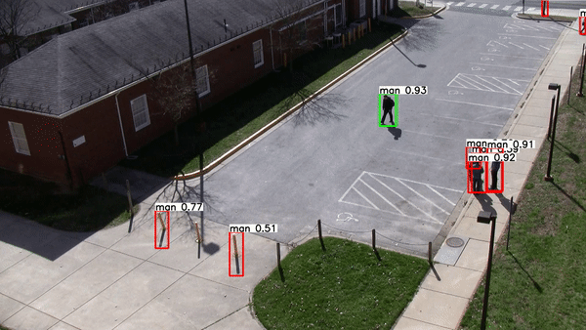
Implementation Onto Video Stream

Slide 12
Next Steps
Collect more Training and Validation Data to make model more precise
Deal with Depth issues for a 3D plane
Implement more Categories to prevent the mismatching of objects
Get with Hang Yin to implement a detector that detects social distancing violations AND mask violations

Slide 13
RESOURCES
YOLOv5
github.com/ultralytics/yolov5
Image Datasets
Google.com/images
Video Datasets
viratdata.org/

Slide 14
Thank You!
Does anyone have any questions?
Thomas Joy II - Data Scientist
tomjjoy123@gmail.com
+1 (718) 869-9409
github.com/tomjjoy
linkedin.com/in/thomas-joy-ii/
This Presentation can be found on GitHub

